Slide 1
City of Ottawa Seasonal Load Restrictions (SLR) Program
Abid Ikram P. Eng.
Infrastructure Assessment Engineer
Asset Management Branch - Roads
August 17, 2018

Slide 2
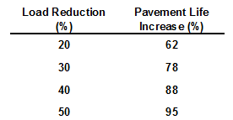
Why Impose SLR?
Pavements that are subject to Freezing can be susceptible to Thaw Weakening
Options to reduce rapid deterioration:
Design/construct pavements to prevent thaw weakening –
  Frost Line is 1.8 m deep in Ottawa – Very expensive option
Apply load restrictions – Less costly, especially if industry can plan around SLR
A recent US study showed that load reductions during the spring thaw period increased pavement life:

Slide 3
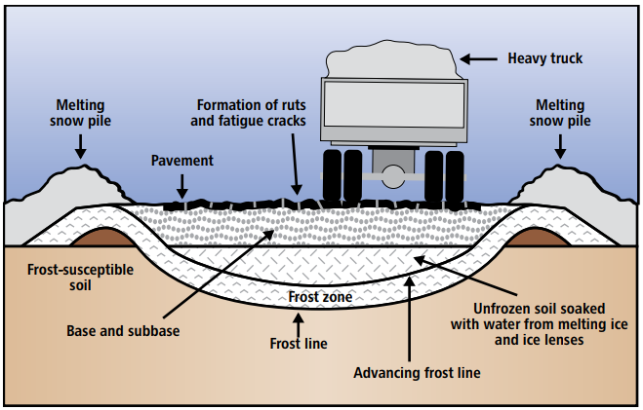
What is Spring Thawing ?
Thawing begins from top - melting ice at the surface creates poor drainage conditions and the underlying frozen subgrade traps the water released
Poor drainage from side ditches, snow piles and the presence of ground water weakens the subgrade and the bearing capacity may reduce by up to 70%
No load restrictions are required at a cold but dry locations
1. Ministry of Transportation Quebec website

Slide 4
Which Roads to Restrict?
Truck routes designation is decided by Traffic Services Group
Asset Management Branch - Roads group provide feedback on pavement strength
Annually meet in January/February to discuss any updates to the truck route maps
New maps available in 1st week of March
City of Ottawa uses the following data for pavement strength evaluation:
Comparison of summer and spring deflections – FWD
Pavement structural thickness – Borehole Data
Subgrade type – Borehole Data

Slide 5
When to Implement SLR ?
It is difficult to determine the exact date and duration:
Delay/shorter duration => Pavement Deterioration
Premature/longer duration => Economic Hardship
Methods generally used across jurisdictions:
Deflection testing | time consuming expensive rate of change not predictable
Historical weather data | fixed dates/duration may be misleading
Frost tube observations | accurate difficult to provide advance notice
Freeze and thaw indexes Thermal analysis of weather forecast data from Environment Canada and Weather Network | convenient staff time only 1-2 week advance notice

Slide 6
When to Implement SLR ? Cont. ....
Implementation Date by 14-day forecast data = March 3, 2018.
Actual Implementation Dates:
City of Ottawa = March 05, 2018
Town of Renfrew = March 05, 2018
MTO (Schedule 2) = March 01, 2018
MTQ (Zone 1) = March 05, 2018

Slide 7
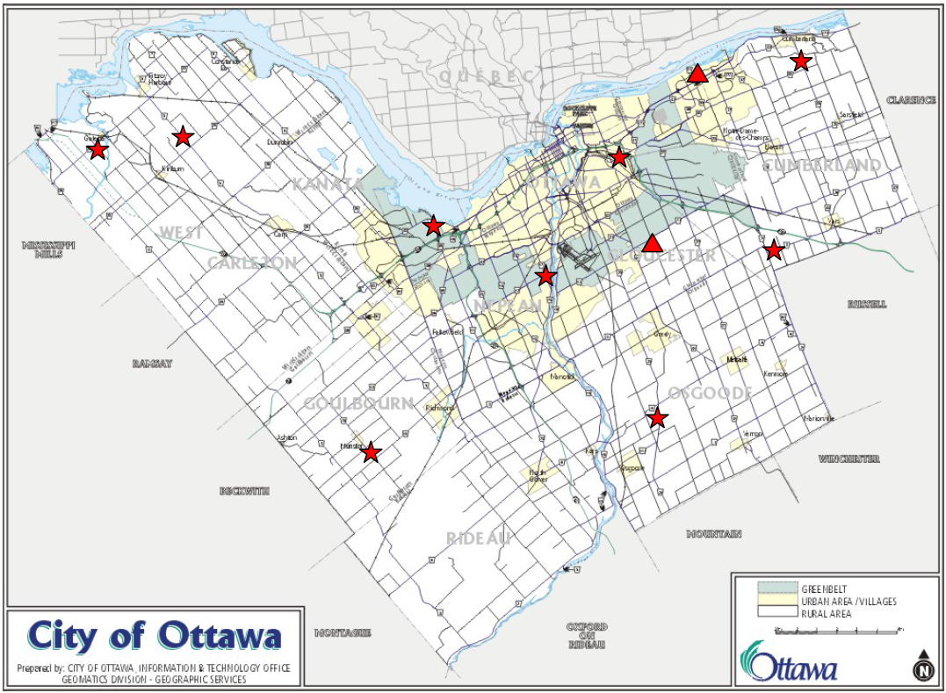
When to Remove SLR ?
City of Ottawa uses Dynaflect Testing and Indexes for the SLR removal date
Dynaflect Deflection Testing:
Weekly deflection testing at 11 test sites throughout the City
The average deflection of all test sites is called Average Seasonal Value (ASV)
Analysis of the 15-year deflection data indicated an ASV of 0.92 mils as the Threshold value for the SLR Implementation and Removal
When the ASV increases above 0.92 mils – Start of Spring Thaw
When the ASV decreases to/below 0.92 mils – Subgrade Strength Regained

Slide 8
When to Remove SLR ? Cont.….
City of Ottawa reviews the following to determine removal date:
dates predicted by deflection testing
dates predicted by indexes
MTO, MTQ and County of Renfrew dates for SLR removal
2018 results:
Actual removal dates:
Deflection Testing | 1st - 2nd week of June
Thermal Models | May 19
City of Ottawa County of Renfrew | May 22
MTO (Schedule 2) | May 31
MTQ (Zone 1) | May 4

Slide 9
City of Ottawa Past 7-year Predicted and Actual Dates
YEAR | SLR IMPLEMENTATION DATE |  | SLR REMOVAL DATE
 | PREDICTED | ACTUAL | PREDICTED | ACTUAL
2012 | 14-Mar | 15-Mar (Thursday) | 14-May | 09-May (Wednesday)
2013 | 11-Mar | 13-Mar (Wednesday) | 07-May | 07-May (Tuesday)
2014 | 22-Mar | 22-Mar (Saturday) | 20-May | 20-May (Tuesday)
2015 | 15-Mar | 23-Mar (Monday) | 22-May | 19-May (Tuesday)
2016 | 09-Mar | 14-Mar (Monday) | 14-May | 13-May (Friday)
2017 | 10-Mar | 15-Mar (Monday) | 15-Jun | 29-May (Thursday)
2018 | 04-Mar | 05-Mar (Monday) | 10-Jun | 22-May (Friday)

Slide 10
Who to Notify ?
External Stakeholders:
National Capital Heavy Construction Association (NCHCA)
Ottawa Construction Association (OCA)
Greater Ottawa Trucker Association (GOTA)
Canadian Trucking Alliance (CTA)
Quebec Trucking Association
Building Owners and Managers Association of Ottawa (BOMA)
Greater Ottawa Home Builders Association (GOHBA)
Internal Stakeholders:
All Directors, Program Managers, Area Managers and other City Staff
Ottawa Police Service

Slide 11
How to Notify – Communication ?
Before Implementation Date Prediction:
Annual memo sent to the external stakeholders – January/February
Meet with OPS for better enforcement
When Implementation and Removal Dates are Predicted:
Public Service Announcement (PSA) posted on City’s website
PSA is issued directly to all Ottawa media outlets
Notification is published on the City’s social media channels – Twitter and Facebook
E-mail Notification
SLR information is updated on City’s website

Slide 12
Questions??

